Slide 1


CRUK CI cluster introduction (III of III)
Some advanced topics

Slide 2
Reference Genomes
Path to reference data:
/scratchb/bioinformatics/reference_data/reference_genomes/
Path to assembly:
…/organism/assembly/
What we maintain:
Genome sequence (fasta)
Alignment indices: BWA, TopHat, Bowtie (1,2)
Annotations:
GTF format gene model
RefFlat format gene model
Signal artifact list (if available)

Slide 3
Working with Lustre
Revisit architecture
Stripes
Avoiding I/O Bottlenecks
Using System Cache
Lustre: Quick Review
Lustre is a massively parallel distributed file system
Deployed in 7 out of 10 most powerful supercomputers
POSIX compliant
Lustre design paradigm concepts
Separation of file meta-data and storage allocation
Scalable data serving through parallel data striping
Aggregates network bandwidth
Distributed operation
’scratch’ storage we (deliberately) don't back it up

Slide 4
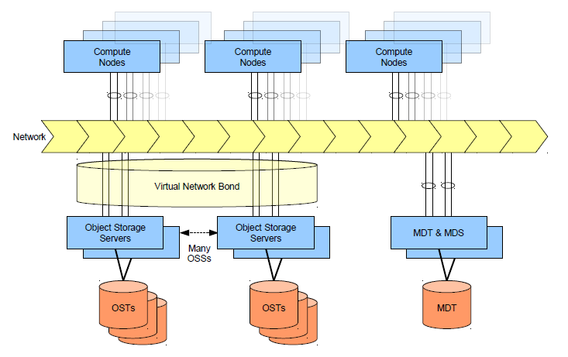
Lustre Architecture …

Slide 5
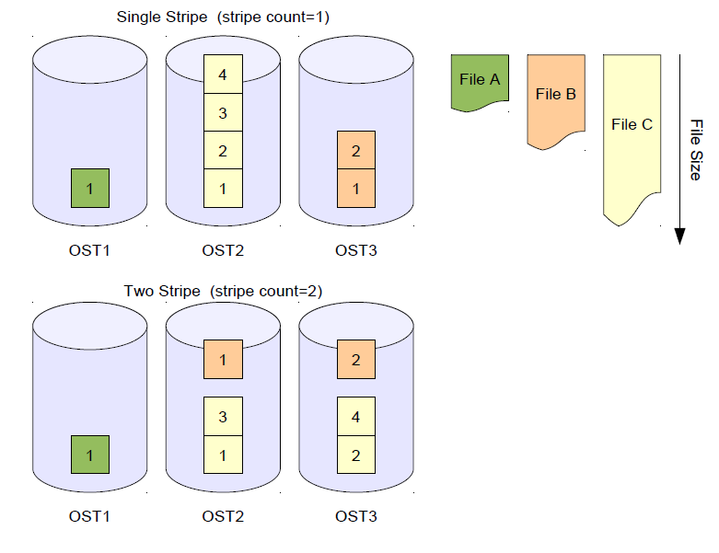
…and File Striping

Slide 6
File Striping Large Files
Striping allows file size to exceed single OST size
Performance benefit
Aggregates I/O bandwidth to single large file
In general, more strips improves performance
Small overhead associated with open/closing striped files
Many jobs reading single file
For example blastdb and maq reference data
/lustre/reference_data/genomes
Many jobs reading & writing multiple large files
Requires benchmarking
Many jobs writing to single file
High bandwidth but requires careful coding (can be disastrous)

Slide 7
Set Stripe Information
Set per file or directory
Default is not to stripe
Only newly created files will be stripes
Use cp (not mv) to migrate existing files
Where,
size = stripe size specified in k, m or g (0 default 1MB)
count = OST stripe count (0 defaults 4 OST and -1 over all OSTs)
index = OST index of first stripe (-1 indicating default)
clust1-headnode ~ $ lfs setstripe <file|dir> --size <stripe_size>
--count <count> --index <index>

Slide 8
Read Stripe Information
Inspect file and directory stripe information with lfs getstripe
uk-cri-lcst01 ~ $ lfs getstripe -d /lustre/reference_data/genomes
stripe_count: 65535 stripe_size: 0 stripe_offset: 0
uk-cri-lcst01 ~ $ lfs getstripe -d /lustre/reference_data
stripe_count: 1 stripe_size: 1048576 stripe_offset: 0
uk-cri-lcst01 ~ $ lfs getstripe zma.3.ebwt
/lustre/reference_data/genomes/Zea_mays/zma.3.ebwt
lmm_stripe_count: 16
lmm_stripe_size: 1048576
lmm_stripe_offset: 11
obdidx objid objid group
11 623006 0x9819e 0
0 8504376 0x81c438 0
.. .... .... .
12 622252 0x97eac 0
8 607894 0x94696 0

Slide 9
Using System Cache
Disk access is slow (no escape from this!)
Memory access measured in a few nanoseconds
Disc access measured in 10s of milliseconds
Linux uses free memory as cache
Memory reclaimed as least used files expunged
“Pre-warming” cache
Can increase I/O performance
uk-cri-lcst01 ~ $ cat largefile > /dev/null
uk-cri-lcst01 ~ $ grep searchString largefile

Slide 10
Avoiding Cache misses
Say you want to compare 3 sequences against 3 large databases:
“Out of the box” example
sequence 1 vs database 1 No cache: disk read required
sequence 1 vs database 2 Cache miss: disk read required
sequence 1 vs database 3 Cache miss: disk read required
sequence 2 vs database 1 No cache: data expunged from cache
sequence 2 vs database 2 Cache miss: disk read required
Re-ordering to avoid cache misses
sequence 1 vs database 1 No cache: disk read required
sequence 2 vs database 1 Cache hit: data in cache
sequence 3 vs database 1 Cache hit: data in cache
sequence 1 vs database 2 No cache: disk read required
sequence 2 vs database 2 Cache hit: data in cache

Slide 11
Avoiding Bad Performance
· Interactive use
Statting files can be slow (common with shared file systems)
Avoid directly editing small files on lustre (keep to /home)
Turn off “color ls” (stat required for each file/directory)
Random seeks
Small random I/O extremely slow on lustre
Avoid, as much as possible, running databases on lustre
e.g. mysql, sqlite, Berkeley DB etc
Limit number of files in directory
10,000s files in single directory bad (avoid, if possible)
Use lfs setstripe to confine all files to single OST – obviously for small files only!
uk-cri-lcst01 ~ $ lfs setstripe --count 1 directory

Slide 12
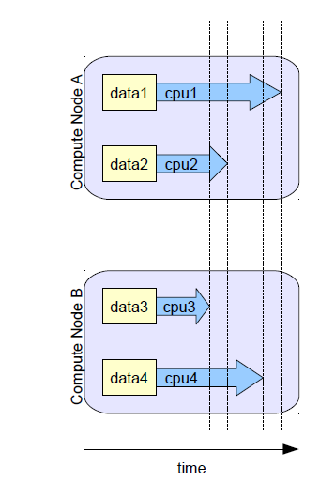
Simple Parallel
(‘Embarassing’ or ‘Trivial’ in the computing science literature)
Solving many similar and independent tasks
Analysis split into tasks
Task assigned to one cpu
No inter-task communication
More throughput by running more tasks
Task runtime varies
90% of bioinformatics codes fall into this model

Slide 13
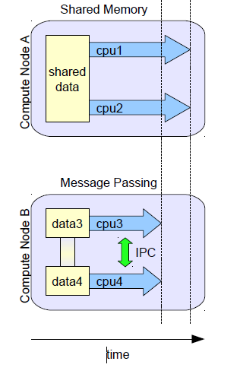
Shared Memory
Shared tasks and memory
Tasks assigned to cpus or cores
Inter-task communication via shared memory
Runtime decreases by adding more threads
Message Passing - local
Multiple processes communicate using O/S level systems. Code must be specifically written to exploit parallelism
OpenMP/OpenMPI/etc

Slide 14
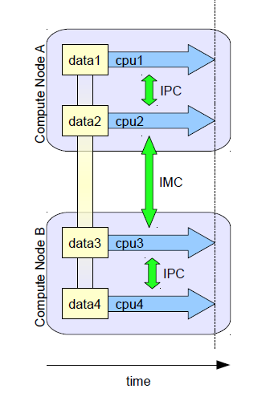
Message passing over network
Single task split across many compute nodes
inter-machine communication (IMC)
through MPI/OpenMP libraries again
Hybrid models
Single task split across many compute nodes
Mix SMP, local MP, network MP
Can be tricky to predict performance.
Your code may get quite complex…

Slide 15
Parallel Workloads
What happens when you increase your dataset size?
O(n), O(n log n), O(n² ), O(n⁹ )
Runtime & memory increase (O) with problem size (n)
Calculations are carried out in parallel
Operating on principle that large calculations can often be divided into N smaller tasks
These tasks are solved concurrently
Time reduces to a function of O(n^{x})/N
Parallel overheads
communication, concurrency, parallel I/O introduce new overheads
O(N), O(N log N), O(N²)
Amdahl's Law
Speed up of parallel application is ultimatley limited by the fixed runtime of any sequence sections
There’s no magic bullet for this, you may have to change your algorithm, or mix parallel and single node sections.

Slide 16
Acknowledgements
Peter Maccallum
Marc O’Brien
Mark Dunning
Ann Pajon

